Slide 1
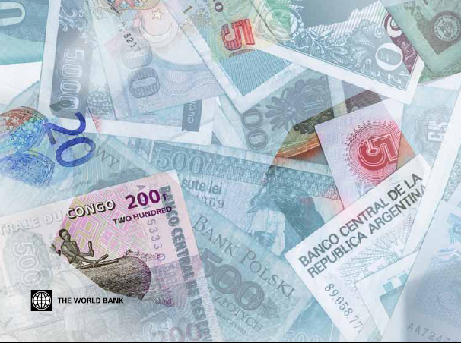
Global Financial Development Report 2013
Rethinking the Role of the State in Finance
Martin Čihák, Lead Economist, World Bank
Warsaw, December 3, 2012
http://www.worldbank.org/financialdevelopment

Slide 2
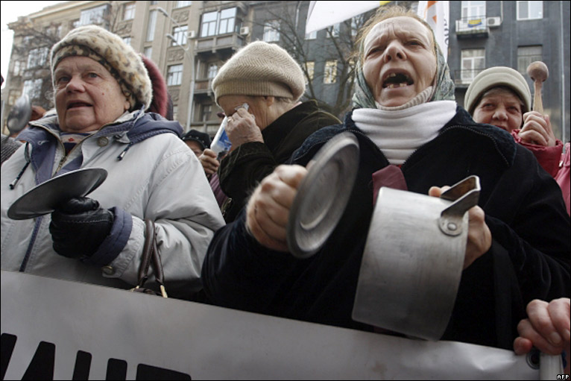
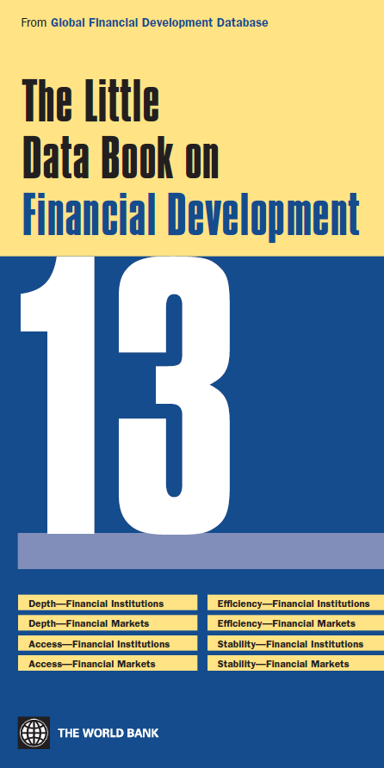
Introducing the Global Financial Development Report
Intro Regulation and Supervision Competition Policy Direct Interventions Infrastructure Main Messages
First in a series
Combines new data, research, lessons from operational work
Collaboration within WBG and with external contributors
Each report will focus on a theme
GFDR 2013: rethinking the state’s role in finance, in light of the global crisis
GFDR 2014: financial inclusion
More than a report
Accompanied by Global Financial Development Database and several other major databases and surveys, benchmarking of financial systems around the world, a range of underlying case studies and research papers
http://www.worldbank.org/financialdevelopment
Source: AFP
Source: AFP

Slide 3
Intro Regulation and Supervision Competition Policy Direct Interventions Infrastructure Main Messages
Global Financial Development Database
 | FINANCIAL INSTITUTIONS | FINANCIAL MARKETS
DEPTH | Private sector credit to GDP Financial institutions’ assets to GDP , M2 to GDP, Deposits to GDP ,Gross value-added of the financial sector to GDP, … | Stock market capitalization plus outstanding domestic private debt securities to GDP Private debt securities to GDP, Public debt securities to GDP, International debt securities to GDP, Stock market capitalization to GDP, Stocks traded to GDP, ….
ACCESS | Accounts per thousand adults Bank branches per 100,000 adults, % of people with a bank account, % of firms with line of credit, % of firms with line of credit, … | Market cap outside of 10 largest companies Percent of value traded outside of top 10 traded companies, Government bond yields (3 month and 10 years), Ratio of domestic to total debt securities, Ratio of private to total debt securities (domestic), Ratio of new corporate bond issues to GDP, ….
EFFICIENCY | Net interest margin Lending-deposits spread, Non-interest income to total income, Overhead costs (% of total assets), Profitability (return on assets, return on equity), Boone indicator (or Herfindahl or H-statistics) | Turnover ratio Price synchronicity (co-movement), Price impact, Liquidity/transaction costs, Quoted bid-ask spread for government bonds, Turnover of bonds (private, public) on securities exchange, Settlement efficiency
STABILITY | Z-score Capital adequacy ratios, asset quality ratios, liquidity ratios, net foreign exchange position to capital, distance to default, … | Volatility of stock price index Skewness of the index, Price/earnings ratio, Duration, Ratio of short-term to total bonds, Correlation with major bond returns
Examples of other variables in the database: ownership of financial institutions, structure (H-statistics etc), measures of internationalization, features of the regulatory and institutional framework, etc.
For the database, see http://www.worldbank.org/financialdevelopment.

Slide 4
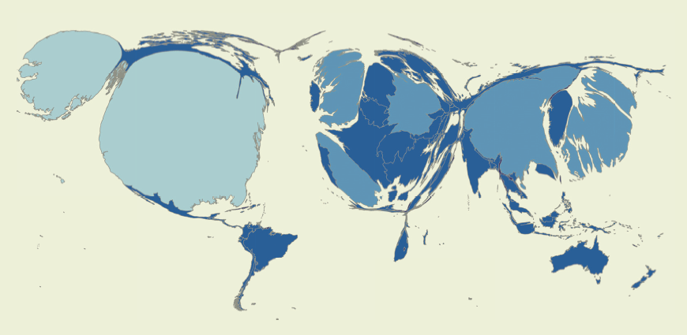
Global Financial Development Database
Intro Regulation and Supervision Competition Policy Direct Interventions Infrastructure Main Messages
Source: Calculations based on the Global Financial Development Database (http://www.worldbank.org/financialdevelopment).
Note: For illustration purposes only. Country sizes adjusted to reflect the volume of financial sector assets in the jurisdiction (U.S. dollars, end-2010). Image created with the help of the MapWindow 4 and ScapeToad software.

Slide 5
Intro Regulation and Supervision Competition Policy Direct Interventions Infrastructure Main Messages
Expert views: Financial Development Barometer
Over 90 % of respondents think that positive effects of financial development outweigh the negative ones. But views are split on important aspects of the state’s role ….
Examples of statements where opinions were split | Agree?
"In view of the global financial crisis, more stringent financial sector regulation and supervision is needed." | 49 %
"In view of the global financial crisis, there is a need for broadening the scope of financial sector regulation and supervision." | 54 %
"More financial sector competition would help financial stability in my home country." | 58 %
“State-owned financial institutions played an effective counter-cyclical role during the recent global financial crisis." | 48 %
“Government-backed credit guarantee schemes play an important role in promoting financial stability." | 64 %
“The development of collateral registries can be left, fully or mostly, to the private sector.” | 42 %
Source: Financial Development Barometer 2011 (http://www.worldbank.org/financialdevelopment). The Barometer is an informal global poll of officials and financial sector experts from 78 economies (30 percent developed, 70 percent developing). The response rate was 65 percent. Results are percentages of total responses received.

Slide 6
Intro Regulation and Supervision Competition Policy Direct Interventions Infrastructure Main Messages
State as regulator and supervisor
Area where role of state undisputed
Crisis: major shortcomings in market discipline and R&S
How to best ensure that R&S supports sound financial development?
Important trade-offs (too much/too little R&S)
Calls for not “more”, but for “right” type of regulation
New WB survey of R&S in 142 countries allows us to investigate two issues and shed new light:
How does R&S and market discipline compare in crisis-hit countries relative to the rest?
How did R&S and market discipline change since the crisis?

Slide 7
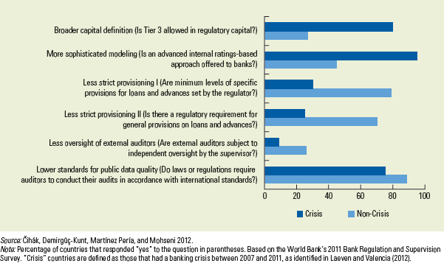
State as regulator and supervisor
Intro Regulation and Supervision Competition Policy Direct Interventions Infrastructure Main Messages

Slide 8
Findings on regulation and supervision
Intro Regulation and Supervision Competition Policy Direct Interventions Infrastructure Main Messages
Crisis hit countries had weaker regulation and supervision practices… (e.g., less stringent capital and provisioning rules, reliance on banks’ own risk assessment)
… and less scope for market incentives (e.g., generous deposit protection coverage, lower quality of published financial information)
After crisis, countries stepped up efforts on macroprudential policy, crisis resolution, and consumer protection
However, unclear whether incentives for market discipline improved
Survey suggests scope for improving disclosures and monitoring incentives
Broad agreement: important to address “basics” first
Simpler but strongly enforced regulation tends to work better
Institutional and legal frameworks that enable market discipline complemented with strong and timely supervisory action
Many developing economies: supervisory capacity = top priority
Challenge: introducing reforms that are incentive-robust (one proposal: “incentive audits”)

Slide 9
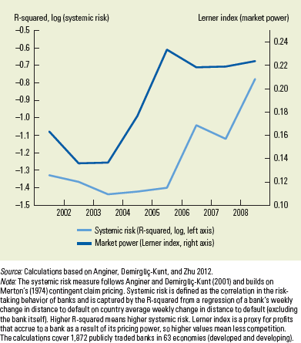
Intro Regulation and Supervision Competition Policy Direct Interventions Infrastructure Main Messages
Role of state in promoting competition
Excessive competition - a reason for the crisis?
Competition leads to improved efficiency across banks, enhances access to financial services while not necessarily eroding systemic stability.
Addressing causes of the crisis requires regulations that align private incentives and public interest (not restricting competition)
Role for the state: market contestability (healthy entry and exit) and availability of credit information and contract enforcement are important to promote healthy competition.
Governments should eliminate distortions in risk-taking (e.g., too-big-to fail subsidies) to limit negative consequences on bank competition.

Slide 10
Direct state interventions
Intro Regulation and Supervision Competition Policy Direct Interventions Infrastructure Main Messages
Crisis re-ignited the debate on the role of state owned banks
Is the counter-cyclical role of state-owned banks in offsetting credit contractions justification enough?
Pros: additional tool for crisis management in the short term
Cons: misallocation and efficiency losses due to politically-motivated lending
Array of strategies to restart the financial and real sectors
Lending to private sector by state-owned banks
Commercial banks: Banco de Estado (Chile), PKO Bank Polski (Poland)
Development banks: BNDES (Brazil), China Development Bank
Credit guarantees
Mexico
Unconventional monetary policies
QE and credit policies by central banks (advanced economies)

Slide 11
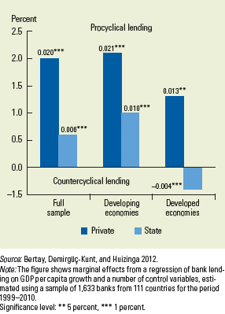
Direct state interventions
Intro Regulation and Supervision Competition Policy Direct Interventions Infrastructure Main Messages
New evidence
State-owned bank lending tends to be less pro-cyclical, and in some countries banks played a short-run counter-cyclical role (ECA vs. LAC)
But loans were not directed to the most constrained borrowers and lending growth by state continued even after recovery.
Trade-offs
Governments need to consider benefits of counter-cyclical lending vs. long-term costs on credit allocation
Past evidence on longer-term costs question the wisdom of such policies
Need to address inefficiencies of state-owned banks
Clear and sustainable mandate
Adequate risk management systems
Sound corporate governance
But good governance practices are challenging to implement in weak institutional environments.

Slide 12
Credit information sharing: some new results
Intro Regulation and Supervision Competition Policy Direct Interventions Infrastructure Main Messages
Important role of the state
promote participation, ensure access and transparency
particularly in concentrated environments; private information sharing is less likely to emerge when banking systems are concentrated; state also has a role in increasing participation beyond banks to non-banks

Slide 13
Main messages
Intro Regulation and Supervision Competition Policy Direct Interventions Infrastructure Main Messages
Needed: balance among the state’s roles
Promoter / owner and guarantor / regulator and supervisor / overseer
Right balance depends on a number of factors, including the level of development and the government’s capacity. This leads to trade-offs.
Direct interventions during the crisis:
Evidence that some worked … partly, in the short run….
…. but also robust evidence on potential longer-term harmful effects
… as crisis subsides, need for rebalancing towards less direct involvement
Overarching theme: role of incentives in finance
the challenge for the state's involvement is to better align private incentives with public interest without taxing or subsidizing private risk-taking

Slide 14
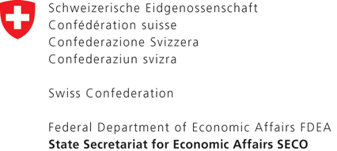
Thank you
Global Financial Development Report 2013 benefitted from support by
http://www.worldbank.org/financialdevelopment

